Slide 1
Updates on Corn Research Topics
Dr. Ignacio A. Ciampitti
Cropping Systems & Crop Production Specialist,
Associate Professor
Department of Agronomy, Kansas State University

Slide 2
Outline
Managing corn for superior yield and profits:
8.
Weekly
scouting
1.
Hybrid
selection
7.
Fertility
tests
2.
Crop
rotation
Yield
6.
Seeding
rate
3.
Planting
Date
5.
Weed
control
4.
Row spacing
< 30 inches

Slide 3
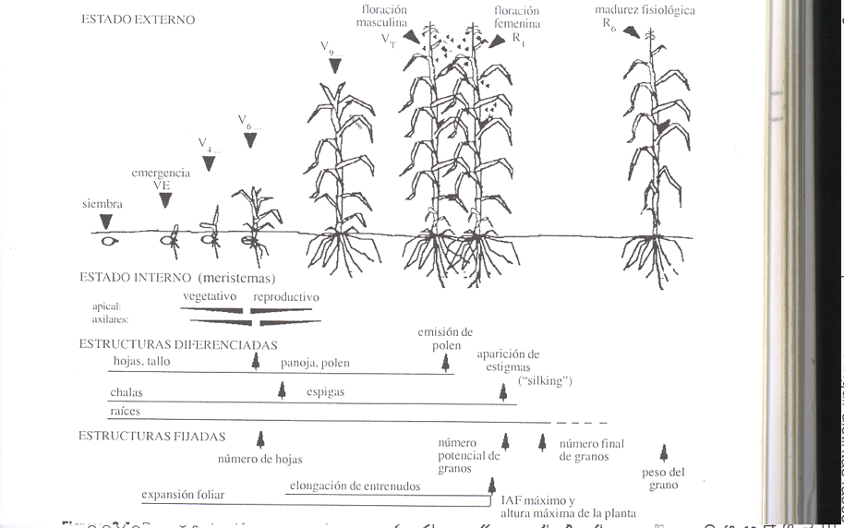
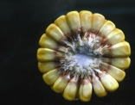
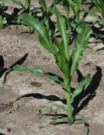

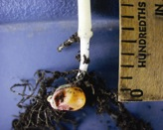
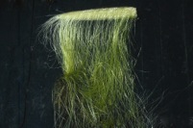
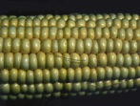


Corn Growth & Phenological Stages
Phenological Stages
V14
Silking
Physiological Maturity
V9
R3
R1
R3
R6
Yields= Kn*Kw
V6
R3
V4
Kernel Number (Kn)
Germination
Kernel Weight
(Kw)
Planting
Critical Period for Kernel Determination
Ciampitti
© K-State Univ, IA Ciampitti

Slide 4
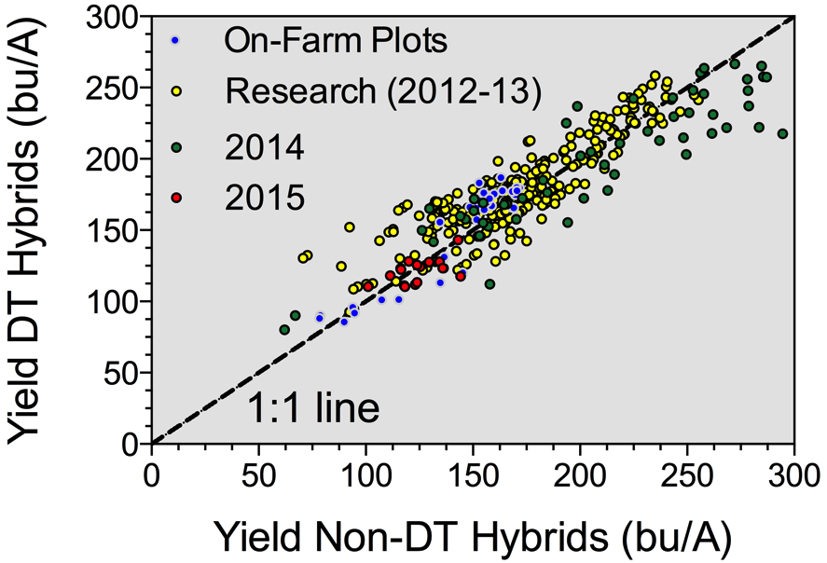
Hybrid selection
65% from the “+” with Yield values < 170 bu/acre

Slide 5
Crop rotation
Crop Response to N in Different Rotations
Yield (Bu/A)
N Rate (Lbs/A)
Continuous corn “yield penalty” is exacerbated as the fertilizer N rate decreases relative to corn-soybean rotations.

Slide 6
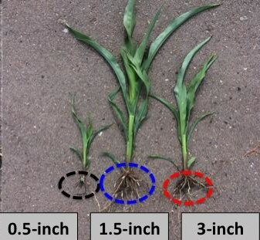
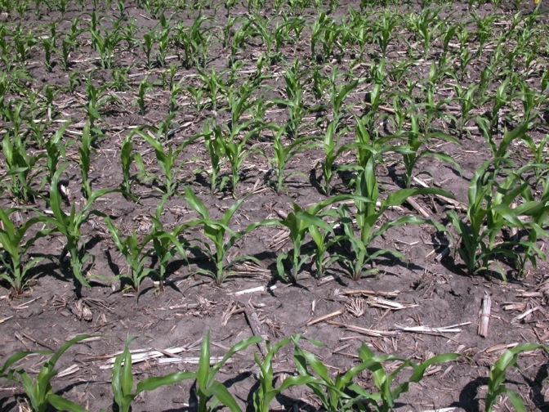
Planting date
Selecting optimal planting date based on soil temperature and moisture conditions – “plant-to-plant uniformity”
Optimum planting depth is critical for early emergence and plant uniformity in corn.

Slide 7
Planting date
Optimum planting depth is critical for early emergence and plant uniformity in corn.

Slide 8
Stressors effect on final yield for corn and soybeans
 |  | SOYBEAN | CORN
Growth Stages |  | ⬇ yield | ⬇ yield
1st week flowering | R1 | 8% | 40-50%
2nd week flowering | R2 | 19% | 30-40%
4th week of flowering | R3 | 36% | 20-30%
2nd -4th week of seed filling | R4 | 39-45% | 20-10%
5th week of seed filling | R5 | 12% | --
175k+fertilized+Fung.Insect
175k+fertilized+Fung.Insect
110k+ fertilized
110k
175k
30 in
30 in
15 in
15 in
15 in
Wright et al. 2006 – Univ. of Minnesota

Slide 9
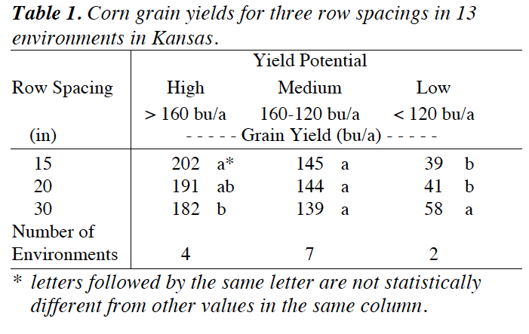
Row spacing
Narrow rows was a positive factor for yields above 150 bu/acre, but recent experience working with on-farm research shows potential benefits even under yields above 100 bu/acre.

Slide 10
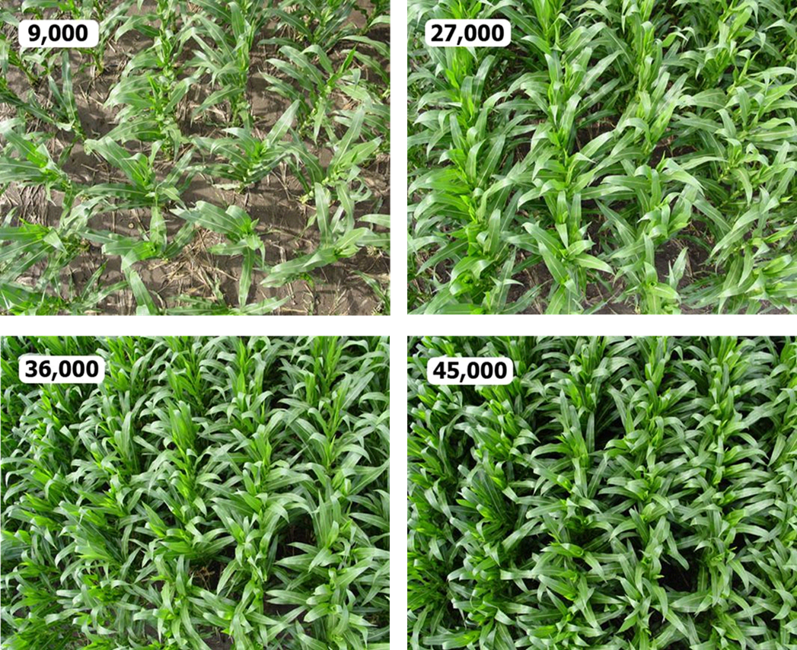
Seeding rate
Dupont Pioneer©

Slide 11
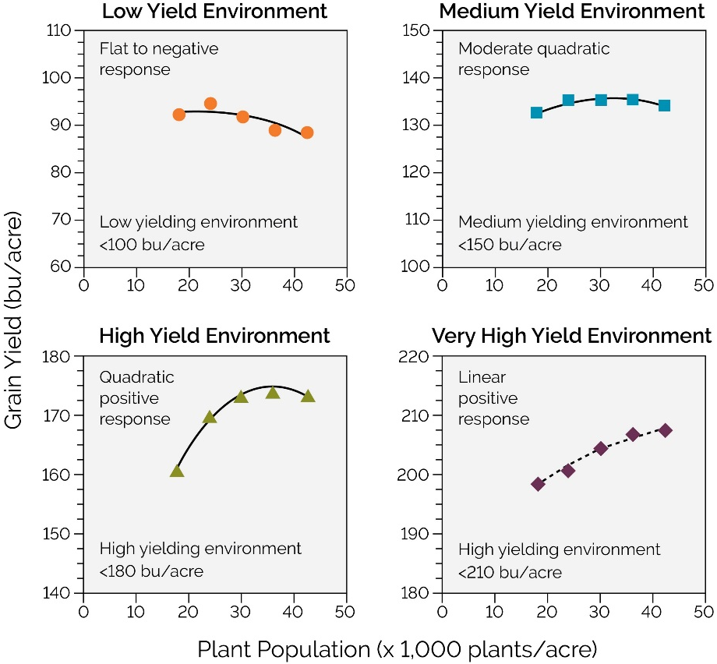
Changes in plant density based on yield target

Slide 12
Database divided by Environment
Grain Yield Data Distribution: Yield
LOW YIELDING ENVIRONMENT <100 bu/acre
      Optimal plant density <20K plants/acre
MEDIUM YIELDING ENVIRONMENT <150 bu/acre
      Optimal plant density 22-26K plants/acre
HIGH YIELDING ENVIRONMENT <180 bu/acre
      Optimal plant density 28-32K plants/acre
VERY HIGH YIELDING ENVIRONMENT 200 bu/acre
      Optimal plant density 32-36K plants/acre
© IA Ciampitti, K-State Univ

Slide 13
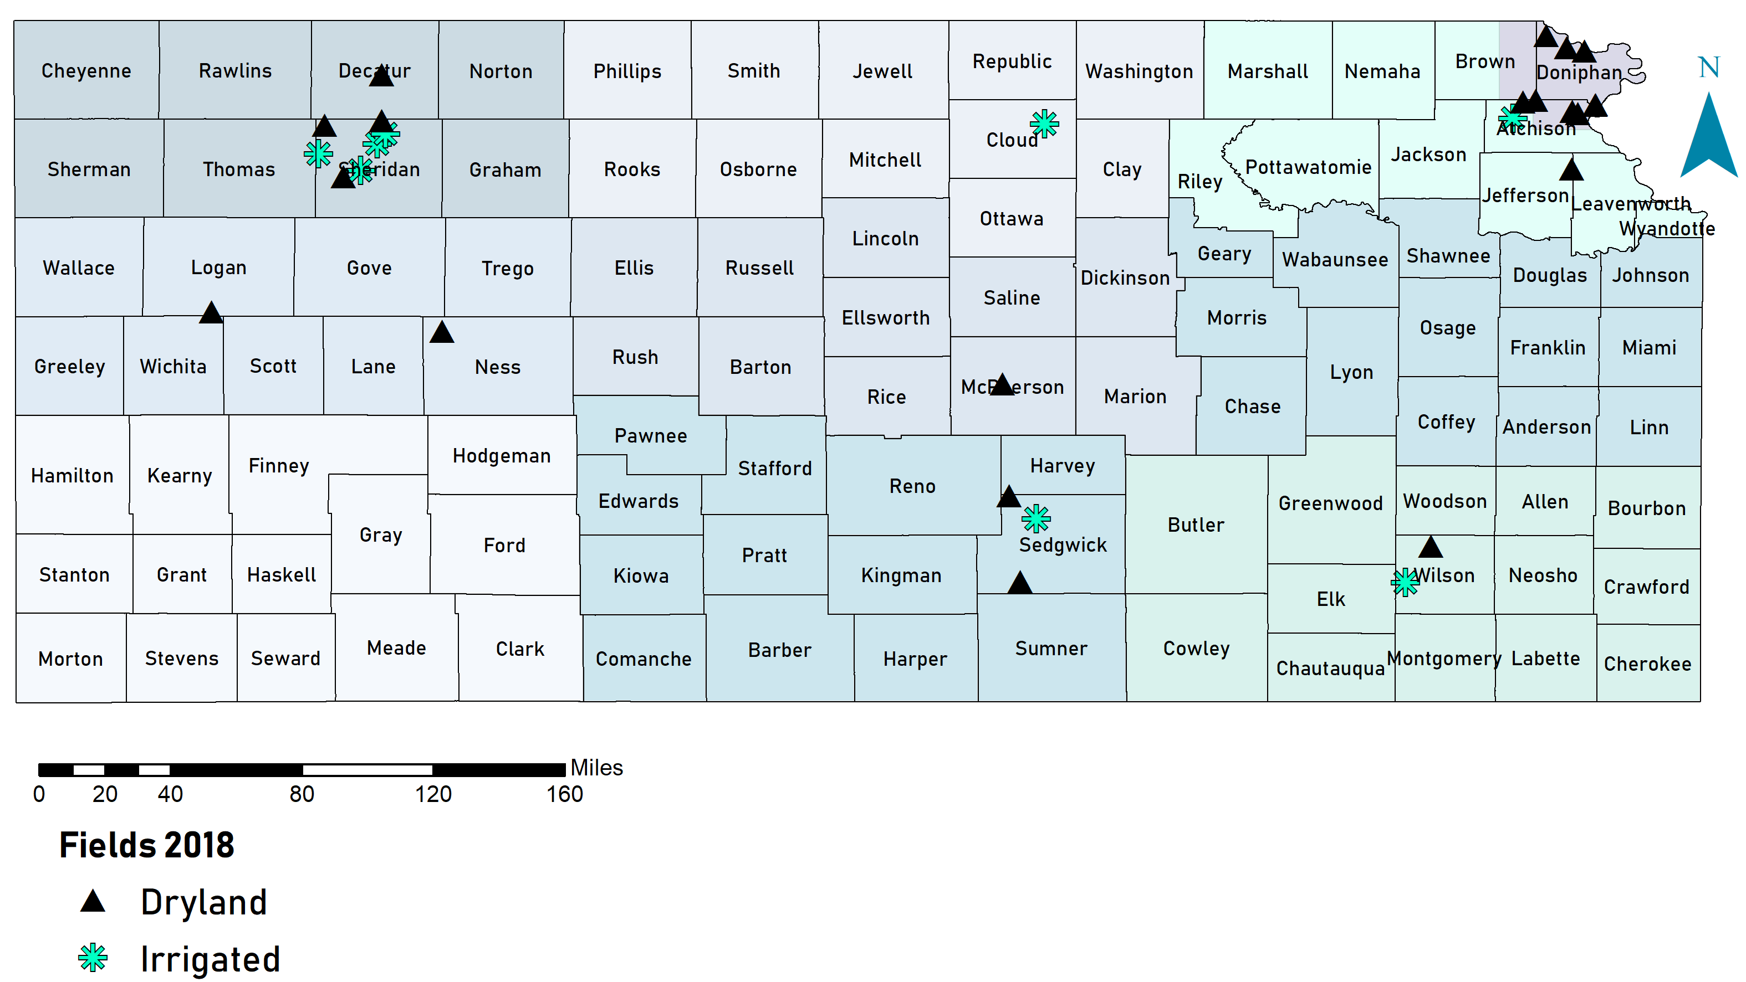
High Yielding Corn – Kansas Corn Yield Contest

Slide 14
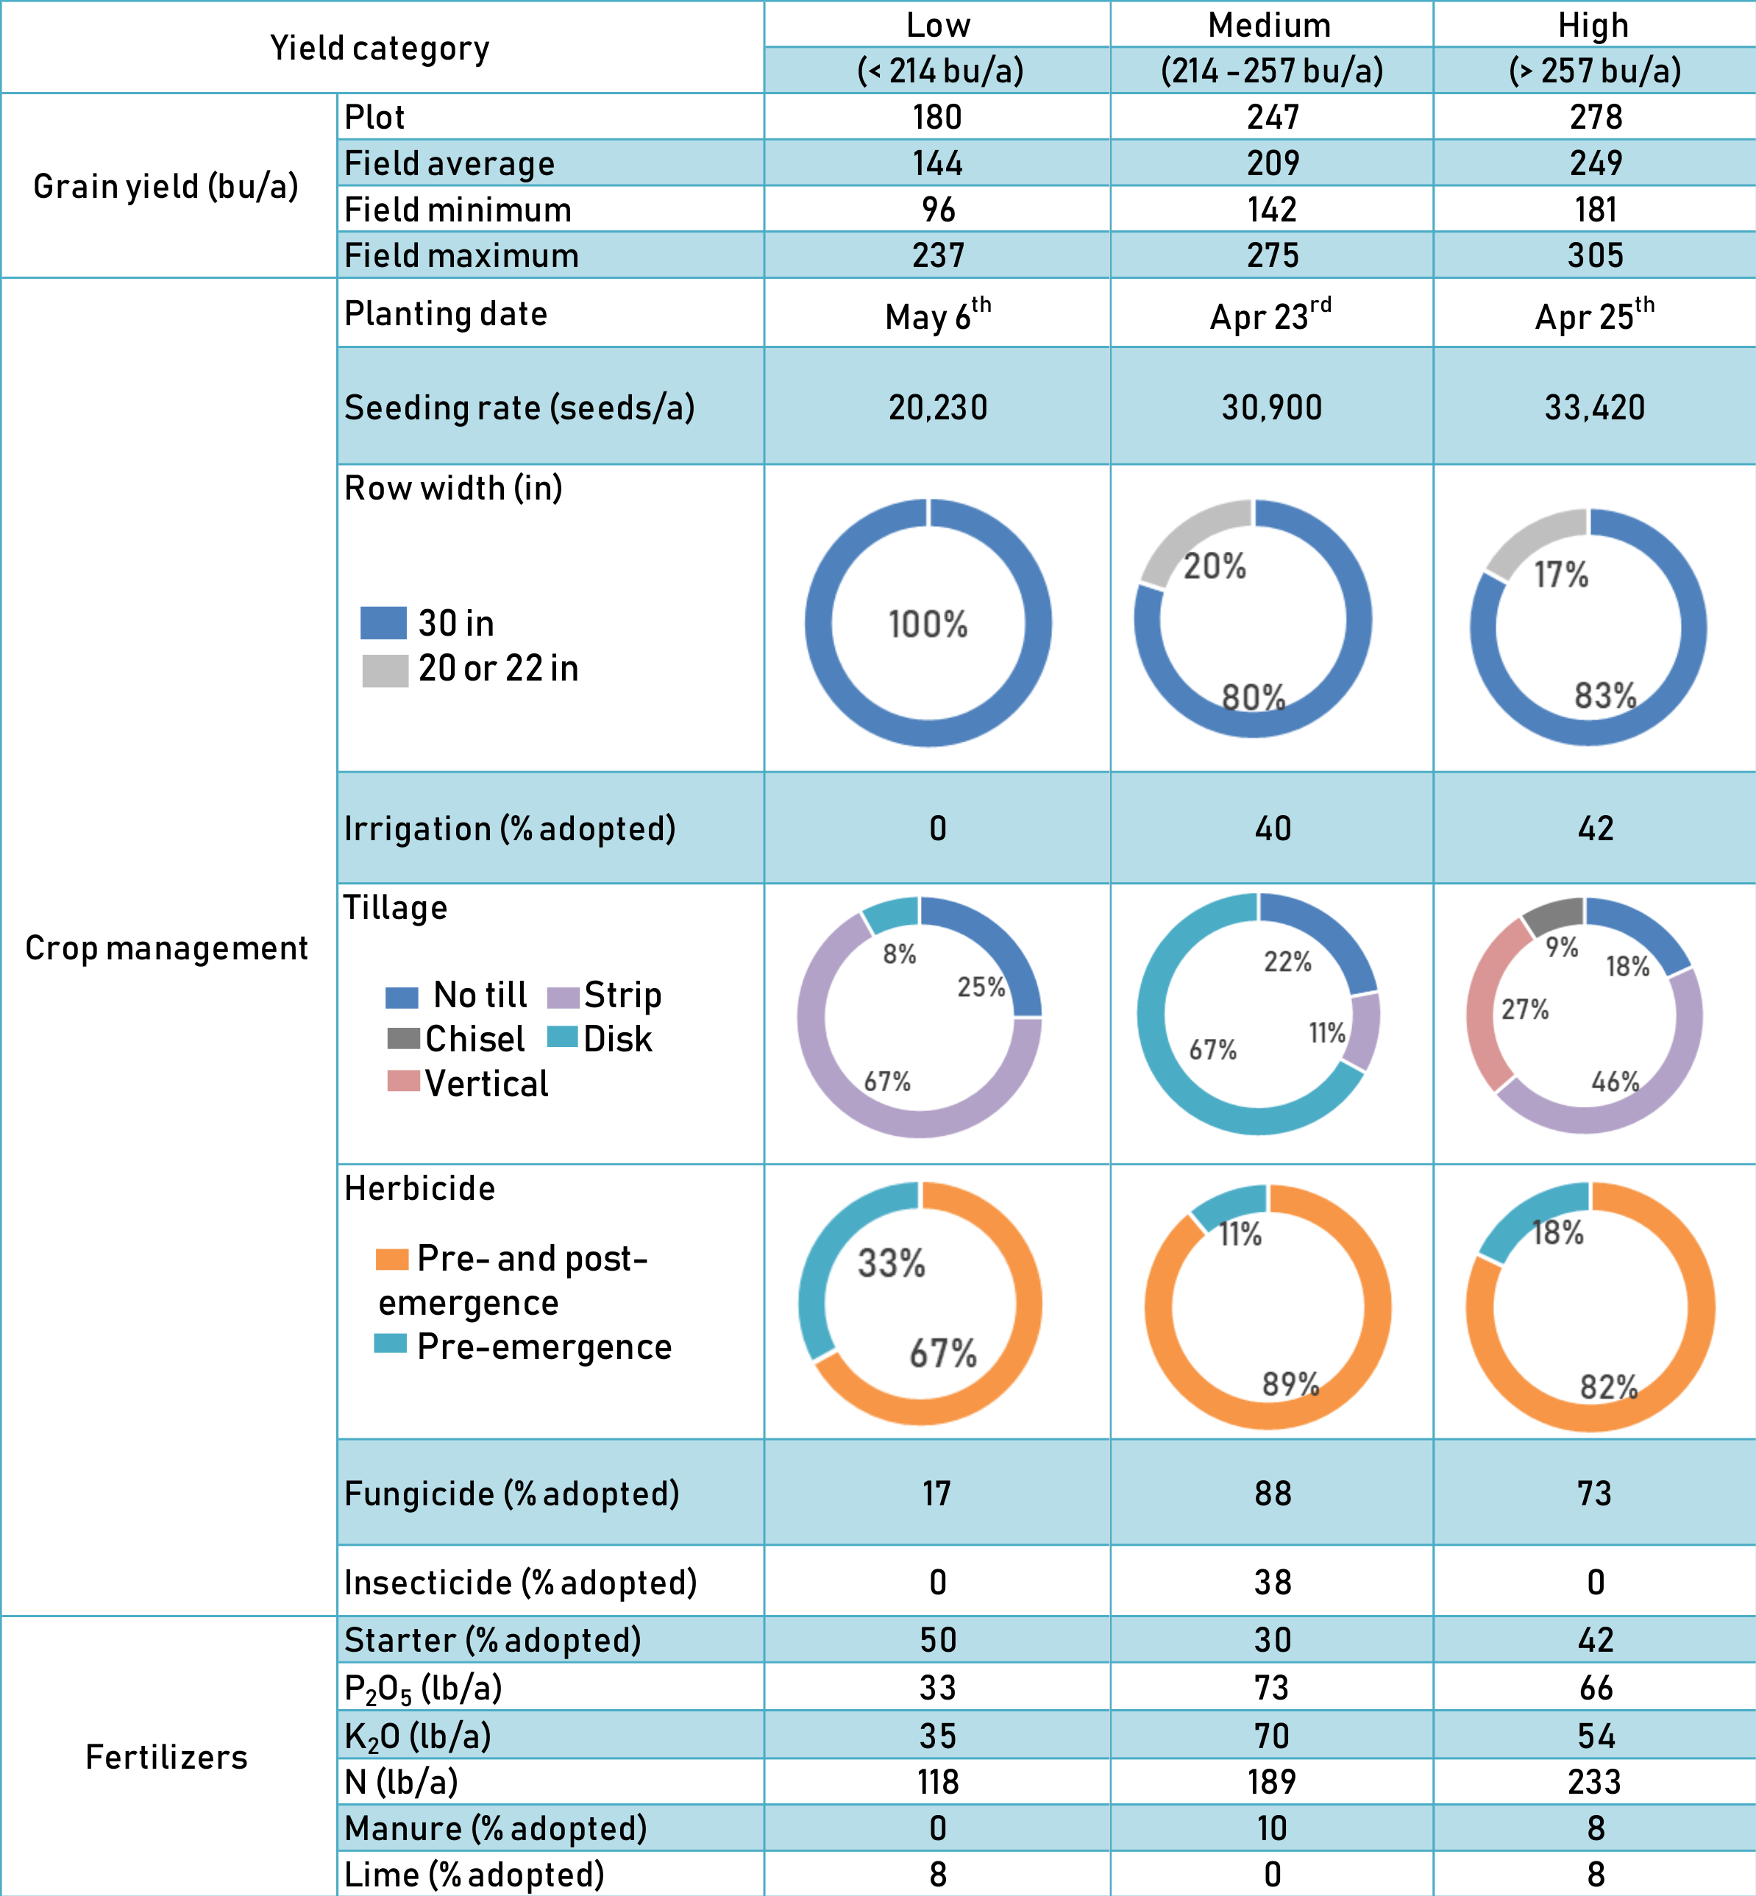
High Yielding Corn – Kansas Corn Yield Contest

Slide 15
High Yielding Corn – Kansas Corn Yield Contest

Slide 16
High Yielding Corn – Kansas Corn Yield Contest

Slide 17
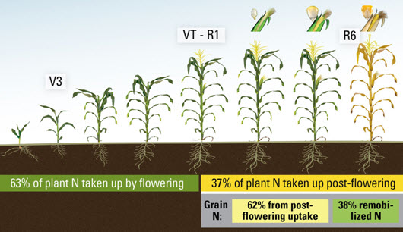

NITROGEN Uptake Dynamics (Yields 200 bu./A)
© IA Ciampitti, K-State Univ

Slide 18
Late-season N application and corn yield
Greater post-flowering N uptake was observed for NEW corn HYBRIDS.
In overall, an increase of 30% of post-flowering N UPTAKE.
Ciampitti, I.A., and T.J. Vyn. 2012. Physiological perspectives of changes over time in maize yield dependency on nitrogen uptake and associated nitrogen efficiencies: a review. Field Crops Research 133:48-67.
Haegele, J.W., K.A. Cook, D.M. Nichols, and F.E. Below. 2013. Changes in nitrogen use traits associated with genetic improvement for grain yield of maize hybrids released in different decades. Crop Sci. 53:1256-1268.
https://www.pioneer.com/home/site/us/agronomy/library/n-uptake-corn/

Slide 19
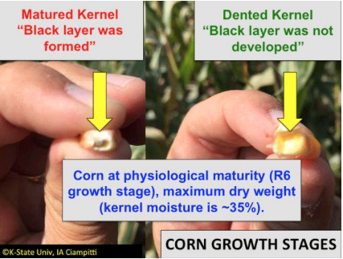
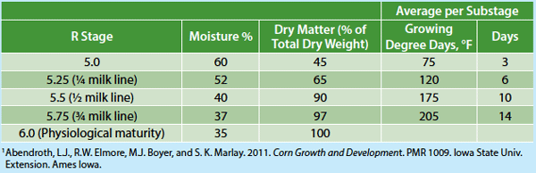
Corn dry down rate:
Environmental effects for end of the season
Based on previous information, the average dry down rate depends on the weather, primarily temperature and moisture conditions – but it might range from 1% in late August to less than 0.5% per day in October.
175k+fertilized+Fung.Insect
175k+fertilized+Fung.Insect
110k+ fertilized
110k
175k
Grain water loss
30 in
30 in
15 in
15 in
15 in
Grain water loss occurs at different rates but with two distinct phases: 1) before “black layer” or maturity (Figure 2), and 2) after black layer.

Slide 20
Corn dry down rate:
Environmental effects for end of the season
175k+fertilized+Fung.Insect
175k+fertilized+Fung.Insect
110k+ fertilized
110k
175k
30 in
30 in
15 in
15 in
15 in
Grain dry down rate from the moment of “black layer” until commercial harvest grain moisture is reached. The overall dry down rate was around 1% per day (from 35% to 13% grain moisture) – taking an overall period of 23 days.

Slide 21
Take home messages...
Management practices can reduce the yield gap.
There are numerous practices producers can implement to manage crop yield
  Rotation, hybrid selection, planting date, seeding rate, critical factors
  Agronomic optimum plant density (AOPD) increased over time, but optimal plant density still depends on the final yield environment
  Interaction with hybrid selection and environment
  Late-season N application is an effective practice to improve fertilizer use efficiency but yield gain might depend on early-season N losses
  Optimizing available growing season resources (water, light, time) will help drive yield

Slide 22



Thank you!
Questions?
Dr. Ignacio A. Ciampitti
Cropping Systems & Crop Production Specialist, Associate Professor
Department of Agronomy, Kansas State University
/ksucrops
ciampitti@ksu.edu
@ksucrops

